Slide 1
U08026 FURTHER OBJECT-ORIENTED PROGRAMMING
Recursion*
David Lightfoot
* See Recursion

Slide 2
AGENDA
Recursion
What it is good for
When not to use recursion
See Horstmann Chapter 18
See Schaum Chapter 9

Slide 3
RECURSION
Self referential (defined in terms of itself)
Natural numbers:
  a) 1 is a natural number
  b) The successor of a natural number is a natural number
Recursion is a programming technique much used in declarative (functional) programming – a different way of getting repetition.

Slide 4

LA VACHE QUI RIT
The laughing-cow (la vache qui rit) package shows a cow wearing a laughing-cow package as an earring,
which shows a cow wearing a laughing-cow package as an earring
which …

Slide 5


Slide 6

STEPHEN COLBERT

Slide 7
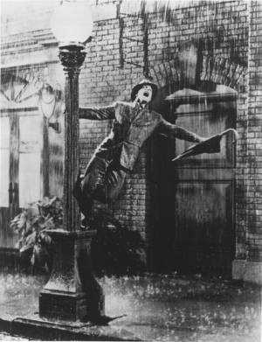
RECURSIVE ENTERTAINMENT
The movie ‘Singin’ in the Rain’ is about making movies.

Slide 8
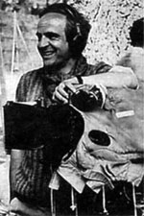

RECURSIVE ENTERTAINMENT
François Truffaut (1932-1984) is the director of ‘la nuit américaine’ (‘Day for Night’).
It is about making a film called ‘Je vous presente Pamela’.
In it Truffaut plays Ferrand, the director of ‘Je vous presente Pamela’
One of the make-up girls plays a make-up girl!

Slide 9

RECURSIVE ENTERTAINMENT
Many television programmes feature people (‘slebs’) who are famous because they appear on television programmes.
‘Famous for being famous’
Why is IBM (Microsoft) successful*?
* Because IBM (Microsoft) is successful!

Slide 10
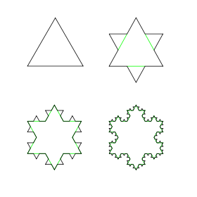
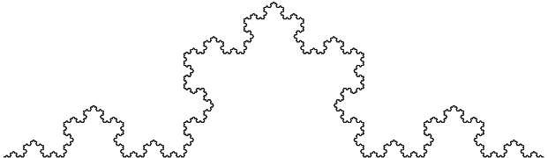
Mathematics patterns: Koch
Niels Fabian Helge von Koch
Koch snowflake

Slide 11
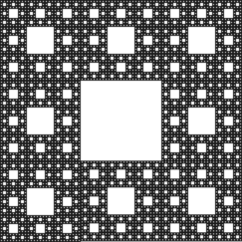
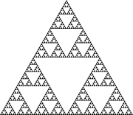
MATHEMATICS PATTERNS: SIERPIŃSKI
Wacław Sierpiński

Slide 12
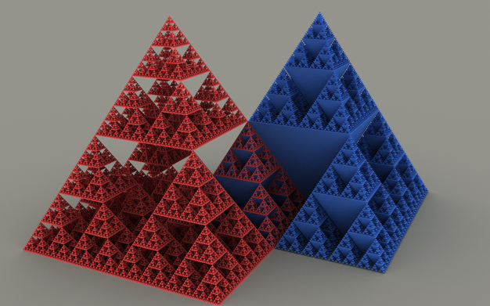
MATHEMATICS PATTERNS: SIERPIŃSKI
Wacław Sierpiński

Slide 13

FRACTALS
Fractals are recursive
The detailed structure mirrors the overall structure
Example: the Barnsley fern.
This is not a photograph: it is generated by a mathematical formula.
Michael Fielding Barnsley is a British mathematician.

Slide 14

ANCESTOR
Define ‘ancestor’
without saying ‘and so on’
and without moving your hands!
An ancestor is:
a) a parent, or
b) a parent’s ancestor
1903 or 1908

Slide 15
FACTORIAL FUNCTION
(the classic example!)
Factorial 5, written 5!, is:
5 × 4 × 3 × 2 × 1
and 6! is
6 × 5 × 4 × 3 × 2 × 1 , so 6 × 5!
Factorial function, for non-negative integers is:
a) 0! = 1
b) if n > 0, then n! = n ×(n – 1)!

Slide 16
IN JAVA
int factorial (int n) {
/* pre: n >= 0
post: factorial(n) = n! */
if (n == 0) then return 1;
else return n * factorial(n – 1);
} /* factorial */
Caution: inefficient and
factorial(n) > maximum integer for quite small n

Slide 17
INFINITE RECURSION (SILLY)
void TellStory() {
System.out.println("It was a dark and stormy night");
System.out.println("and the captain said to the mate");
System.out.println(" 'Tell us a story mate' ");
System.out.println("and this is the story he told … ");
TellStory();
} /* TellStory */

Slide 18
USEFUL RECURSION
To be useful the recursion must terminate, so there must be at least one non-recursive, base case (here it is 0!)
as well as recursive cases.

Slide 19
OTHER EXAMPLES
A linked list is:
a) empty, or
b) has a head (first element)
  and a tail, which is a linked list
A tree is:
empty, or
has a root,
and left and right (sub-) trees

Slide 20
A RECURSIVE CLASS
(FOR LINKED LISTS)
public class Node {
public String data;
public Node next;
public Node(String data) {
this.data = data;
}
}
Here’s the recursive bit! One of the fields of Node is another Node
data
next
data
next
data
next
Have
a
Banana
null

Slide 21
A RECURSIVE CLASS
(FOR LINKED LISTS)
public static void main(String[] args) {
Node n1 = new Node("Have");
Node n2 = new Node("a");
n1.next = n2;
Node n3 = new Node("banana");
n2.next = n3;
Node node = n1;
while (node != null) {
System.out.print(node.data + " ");
node = node.next;
}
}
data
next
data
next
data
next
Have
a
Banana
null

Slide 22
LENGTH OF A LIST
a) the length of an empty list is 0
b) the length of a (non-empty) list is:
1 + the length of the tail of the list

Slide 23
LENGTH OF A LIST IN JAVA: RECURSIVE
int length (Node ls ) {
/* pre: ls is a well formed linked list
post: length(ls) is the number of nodes in the list starting at ls */
if (ls == null) return 0; // empty list
else return 1 + length(ls.next);
// 1+ length of tail of list
} /* length */

Slide 24
ITERATIVE
The term iterative comes from the Latin iter meaning a journey, as in itinerary, itinerant, iteration, iterator, …
In programming it refers to making repetitions by using ‘looping’ statements, such as while, for, …
(as apposed to recursively)

Slide 25
isPresent (ITERATIVE)
static boolean isPresent (int[] a, int x) {
pre: true
post: isPresent(a, x) <=> “there is an x in a”
int i = 0;
while(i != a.length && a[i] != x) {
i++;
} // i == a.length || a[i] == x
return i != a.length;
}

Slide 26
isPresentAux (RECURSIVE)
static boolean isPresentAux(int[] a, int x, int start) {
pre: true
post: isPresent(a, x, start) <=>
“there is an x in a”, starting from start
boolean result;
if (start == a.length) result = false; // empty sequence
else if (a[start] == x) result = true; // found x
else result = isPresentAux(a, x, start+1);
return result;
}

Slide 27
isPresent (RECURSIVE)
static boolean isPresent (int[] a, int x) {
pre: true
post: isPresent(a, x) <=> “there is an x in a”
return isPresentAux(a, x, 0);
}

Slide 28
TRAVERSING A LIST: RECURSIVE, FORWARD
Traversing a (singly) linked list recursively in the forward direction is easy:
void traverse (Node ls) {
if (ls != null) {
Process(ls.data); // process head
traverse(ls.next); // traverse tail of list
}
} /* traverse */

Slide 29
TRAVERSING A LIST: RECURSIVE, BACKWARD
Traversing a (singly) linked list recursively in the backward direction is also easy!:
void reverseTraverse (Node ls) {
if (ls != null) {
reverseTraverse(ls.next);
Process(ls.data);
}
} /* reverseTraverse */

Slide 30
HOW RECURSION WORKS
When a method is called its parameters, local variables and return address are stacked on the method-call stack.
Nested calls lead to deeper stacking.
A call of a method to itself is just another nested call.

Slide 31
WHEN NOT TO USE RECURSION
It is best to use recursive algorithm when the data structure is itself recursively defined
Don’t use a recursive approach when a simple iterative approach is available
Examples: searching, traversing and inserting in a list is easy to do iteratively
Traversing a list backwards (‘backtracking’) is easy to do recursively but hard to do iteratively.

Slide 32
WHEN NOT TO USE RECURSION: EXAMPLE
Fibonacci numbers:
fib₀ = 0
fib₁ = 1
fib_{n} = fib_{n-1} + fib_{n-2}, for n > 0
int fib (int n) { /* doubly recursive */
/* pre: n >= 0
post: fib(n) is the nth Fibonacci number */
if (n == 0) return 0;
else if (n == 1) return 1;
else return fib(n – 1) + fib (n – 2);
} /* fib */
Very inefficient: values repeatedly calculated, then 'forgotten'

Slide 33
ITERATIVE VERSION
int fib (int n) { /* iterative */
/* pre: n >= 0
post: fib(n) is the nth Fibonacci number */
int i, x, y, z;
i= 1; x= 1; y= 0;
while (i != n) {
z= x; i= i + 1;
x= x + y; y= z;
}
return x;
} /* fib */

Slide 34
TRACING RECURSION
Need to take care to know which call is which.
int sum( int arr[], int n ) {
if (n == 0) return 0;
else {
int smallResult = sum( arr, n - 1 ); // A
return smallResult + arr[ n - 1 ];
}
}
http://www.cs.umd.edu/class/fall2002/cmsc214/Tutorial/trace-recursion.html

Slide 35
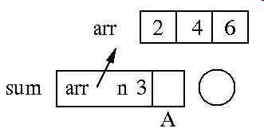
TRACING RECURSION
int sum( int arr[], int n ) {
if (n == 0) return 0;
else {
int smallResult = sum( arr, n - 1 ); // A
return smallResult + arr[ n - 1 ];
}
}
Assume the array contains: { 2, 4, 6 }, and that the call to the sum is:
sum(arr, 3); which will sum the first three elements of the array.

Slide 36
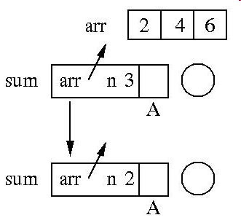
TRACING RECURSION
int sum( int arr[], int n ) {
if (n == 0) return 0;
else {
int smallResult = sum( arr, n - 1 ); // A
return smallResult + arr[ n - 1 ];
}
}

Slide 37
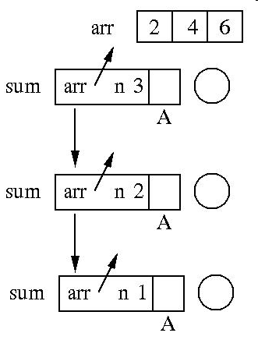
TRACING RECURSION
int sum( int arr[], int n ) {
if (n == 0) return 0;
else {
int smallResult = sum( arr, n - 1 ); // A
return smallResult + arr[ n - 1 ];
}
}

Slide 38
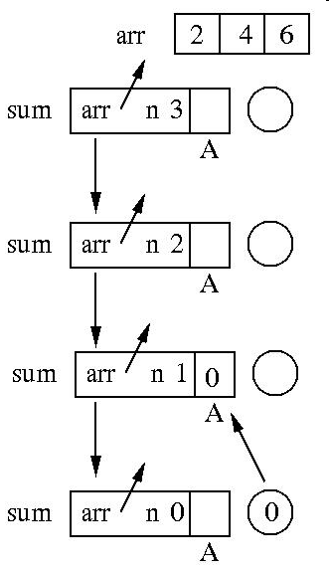
TRACING RECURSION
int sum( int arr[], int n ) {
if (n == 0) return 0;
else {
int smallResult = sum( arr, n - 1 ); // A
return smallResult + arr[ n - 1 ];
}
}

Slide 39
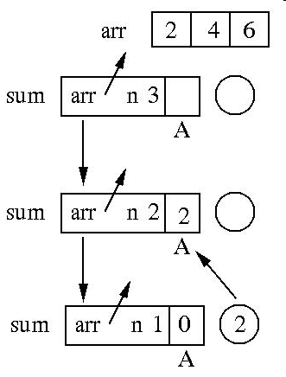
TRACING RECURSION
int sum( int arr[], int n ) {
if (n == 0) return 0;
else {
int smallResult = sum( arr, n - 1 ); // A
return smallResult + arr[ n - 1 ];
}
}

Slide 40
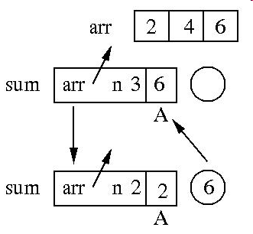
TRACING RECURSION
int sum( int arr[], int n ) {
if (n == 0) return 0;
else {
int smallResult = sum( arr, n - 1 ); // A
return smallResult + arr[ n - 1 ];
}
}

Slide 41
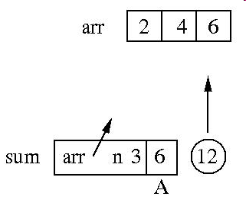
TRACING RECURSION
int sum( int arr[], int n ) {
if (n == 0) return 0;
else {
int smallResult = sum( arr, n - 1 ); // A
return smallResult + arr[ n - 1 ];
}
}

Slide 42
MORAL: THINKING RECURSIVELY
Recursion is like 'magic' – if you believe in it it works!

Slide 43
SUMMARY
After studying the material of this week and attempting the exercises, you should be able to:
understand the concept of recursion
apply a recursive approach to defining an algorithm
know when not to use recursion
know how to trace a recursion
We will use recursion a great deal with trees.

